Slide 1
CS6004NI Application Development
Bishal Gharti Chhetri
bishal.ghartichhetri@islingtoncollege.edu.np
Week-1

Slide 2
Agenda
Overview of this Semester.
ASP.NET Core
What (Overview)
Why (Reasons)
Where (Adoptions)
How (Project Setup)

Slide 3
ASP.NET Core
Free. Cross-platform. Open source.
A framework for building web apps and services with .NET and C#.

Slide 4
Why ASP.NET Core?

Slide 5


Reasons : Know & Love C#

Slide 6
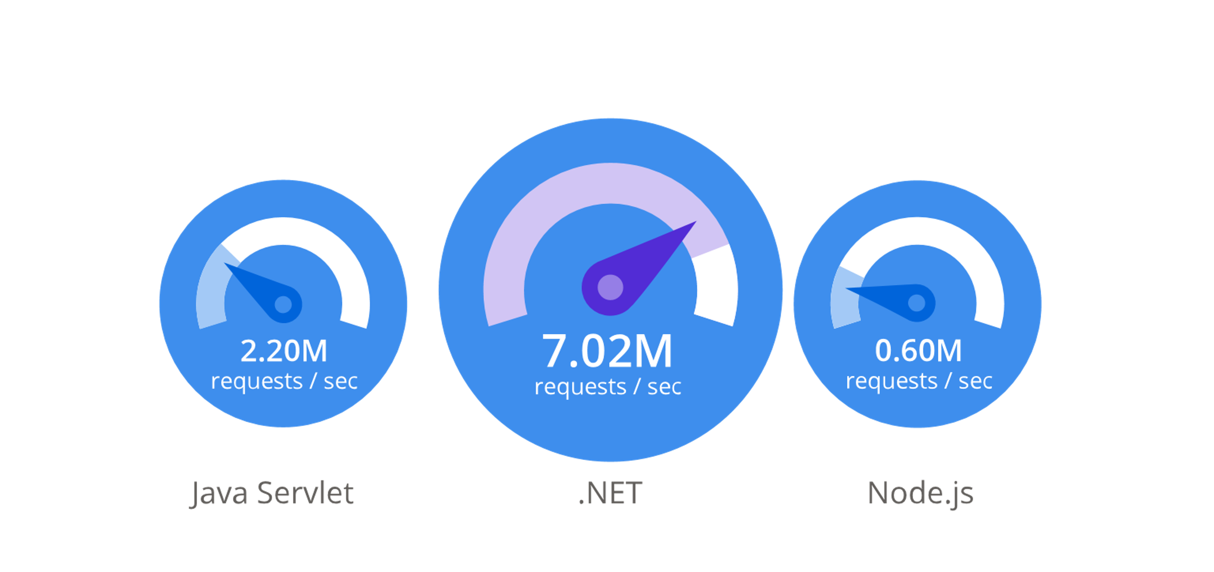
Reasons : Performance

Slide 7
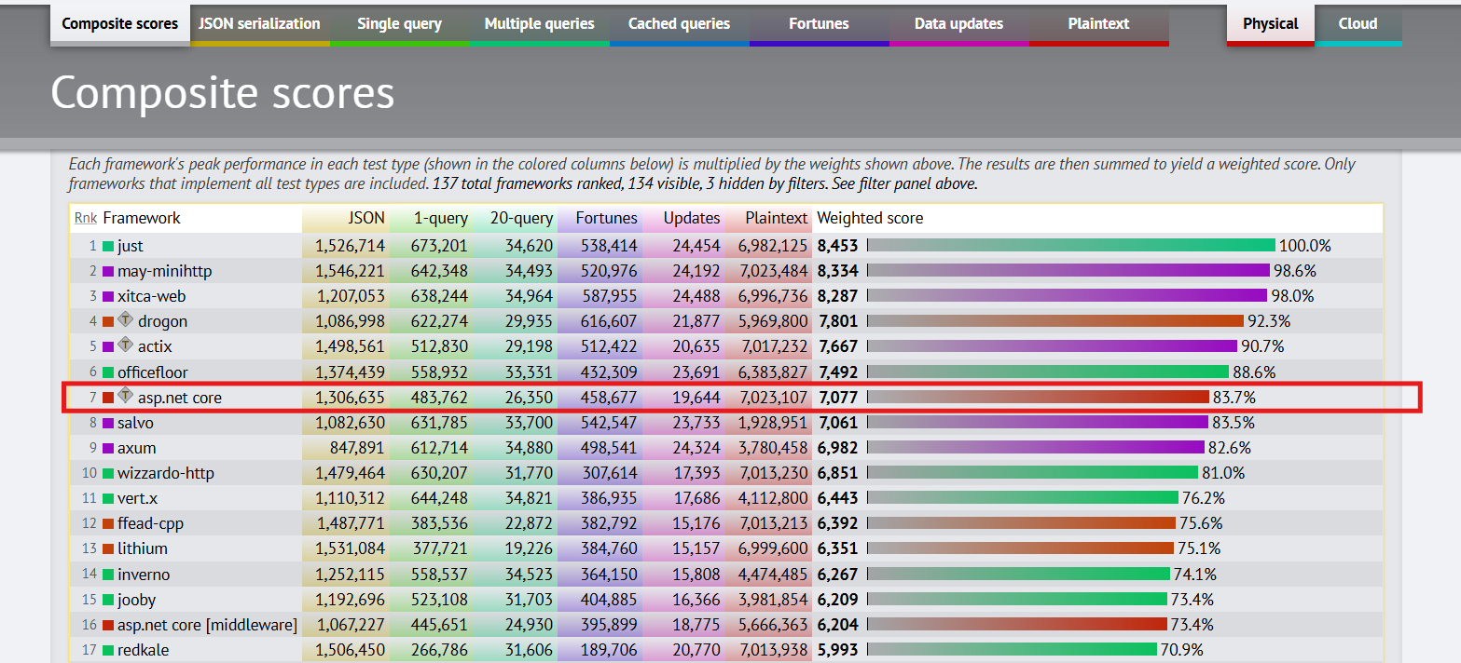
Reasons : Performance (TechEmpower)

Slide 8


Reasons : Supported by Microsoft (Trusted and secure)

Slide 9
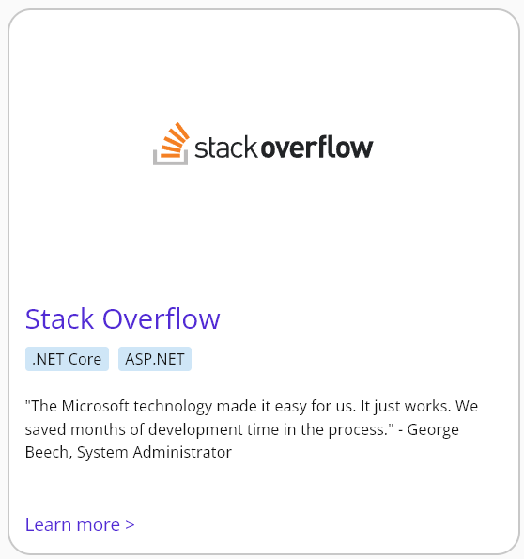
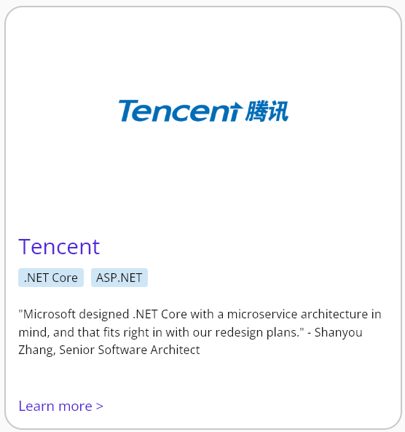
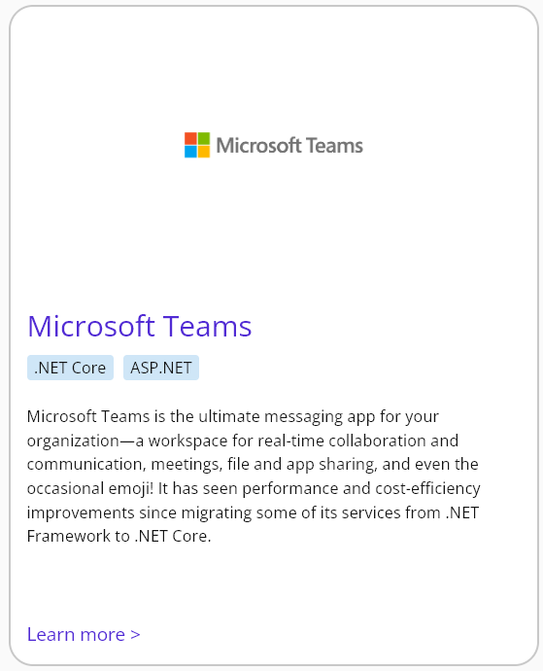
ASP.NET Core Customers

Slide 10
ASP.NET Core Ecosystem
Web Apps | Apis
ASP.NET Core Web App (Model-View-Controller) ASP.NET Core Web App (Razor Pages) Blazor (Hosting Models) Blazor Server Blazor WebAssembly Blazor Hybrid (aka .NET MAUI Blazor Hybrid) | ASP.NET Core Web Api Controller-based Minimal
Real-Time Apps | Remote Procedure Call Apps
SignalR | ASP.NET Core gRPC Service

Slide 11
RESTful Api
Adheres to the REST principles, in contrast to RESTless APIs like SOAP.
Not a framework, protocol, language, or library
Set of constraints, An architectural style, set of rules
Design guidance for Web APIs

Slide 12
RESTful Api > Characteristics (REST Principle)
Client-Server Architecture: The client makes requests, and the server responds.
Request/Response Model
Stateless: Each request is independent, client manage own state, and the server does not store client session data.
Simplicity, Scalability, Reliability
Resource-Based: Everything is a resource (users, products, orders) identified by URIs or Endpoint.
Cacheable: Responses can be cached to improve performance.
Client-Side Cache
CDN Cache (Edge Cache), Reverse Proxy Cache
Application-Level Cache, Distributed Cache
Uniform Interface: Only uses a single protocol, Best use of HTTP, exposing business logic.
Http Methods: Capable of performing CRUD
Http Body: Data exchange format (JSON popularly)

Slide 13
Example
HTTP Method | URL | Description | Example Action
GET | /users | Retrieve a list of users | Fetch all users from the database
GET | /users/{id} | Retrieve a specific user | Fetch details of a user with the given ID
POST | /users | Create a new user | Add a new user to the database
PUT | /users/{id} | Update a specific user's information | Update the user with the given ID
PATCH | /users/{id} | Partially update a user's information | Update only specified fields of the user
DELETE | /users/{id} | Delete a specific user | Remove a user from the database
GET | /users/{id}/posts | Retrieve all posts by a specific user | Fetch all posts related to a given user
POST | /users/{id}/posts | Create a new post for a specific user | Add a new post for the user with the given ID
DELETE | /users/{id}/posts/{postId} | Delete a specific post by a user | Remove a specific post created by the user

Slide 14
Setting-up ASP.NET Core

Slide 15
Prerequisites
.NET SDK (v8)
Editor
IDE
Visual Studio
ASP.NET Workload (tools, templates)
Rider
Code Editor (Visual Studio Code with C# Dev Kit extension)

Slide 16
Verify .NET SDK Installation
Run dotnet --info or dotnet --list-runtimes

Slide 17
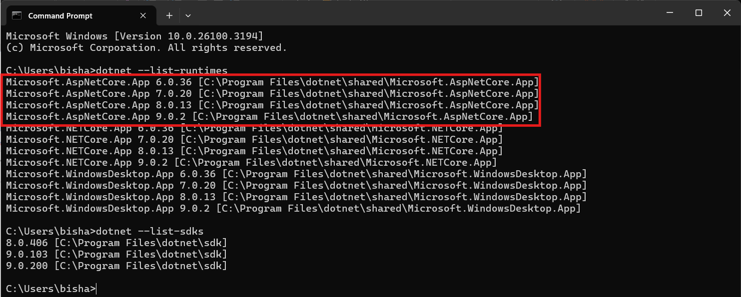
Verify .NET SDK Installation

Slide 18



Editor
JetBrains Rider
Microsoft Visual Studio
Microsoft Visual Studio Code

Slide 19
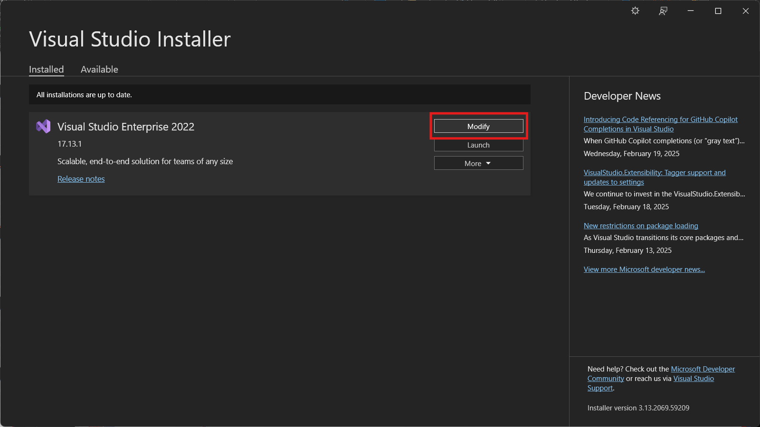
VS > Install ASP.NET Workload

Slide 20
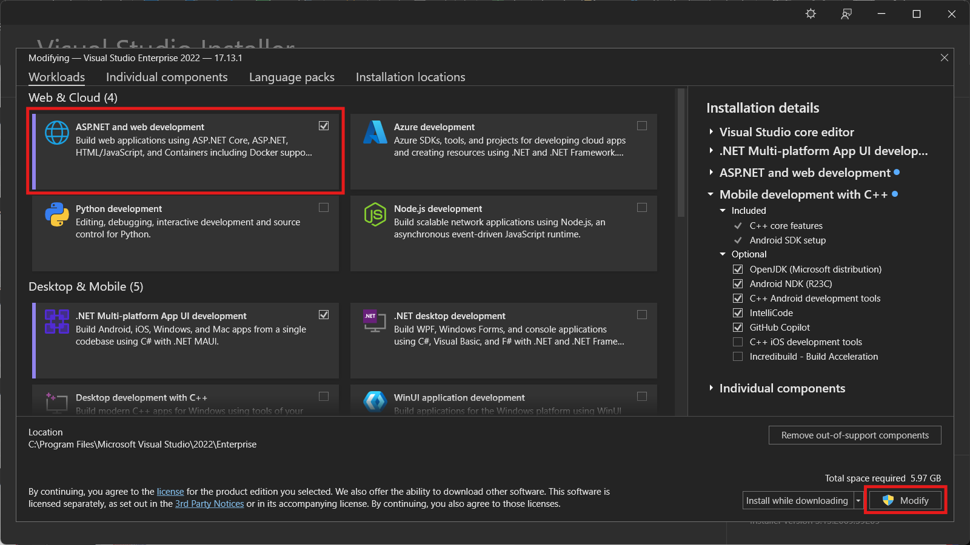
VS > Install ASP.NET Workload

Slide 21
Project Setup

Slide 22
Visual Studio
(Windows Only)
https://visualstudio.microsoft.com/

Slide 23
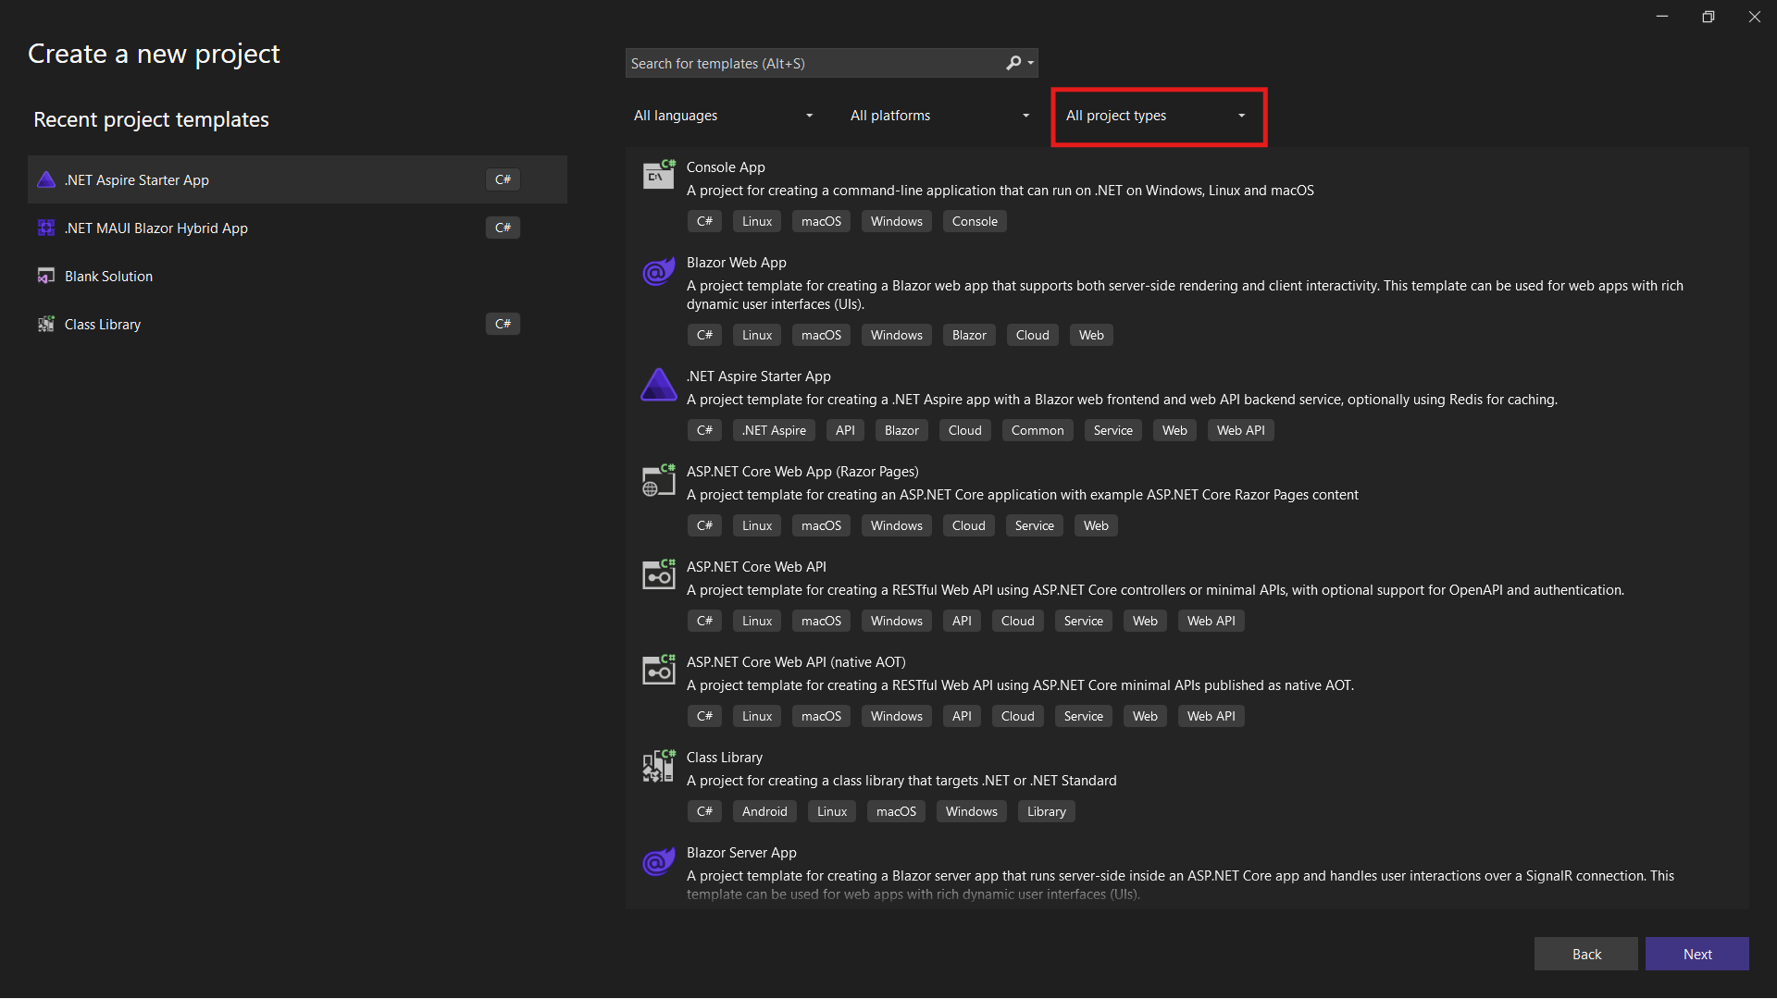
Visual Studio

Slide 24
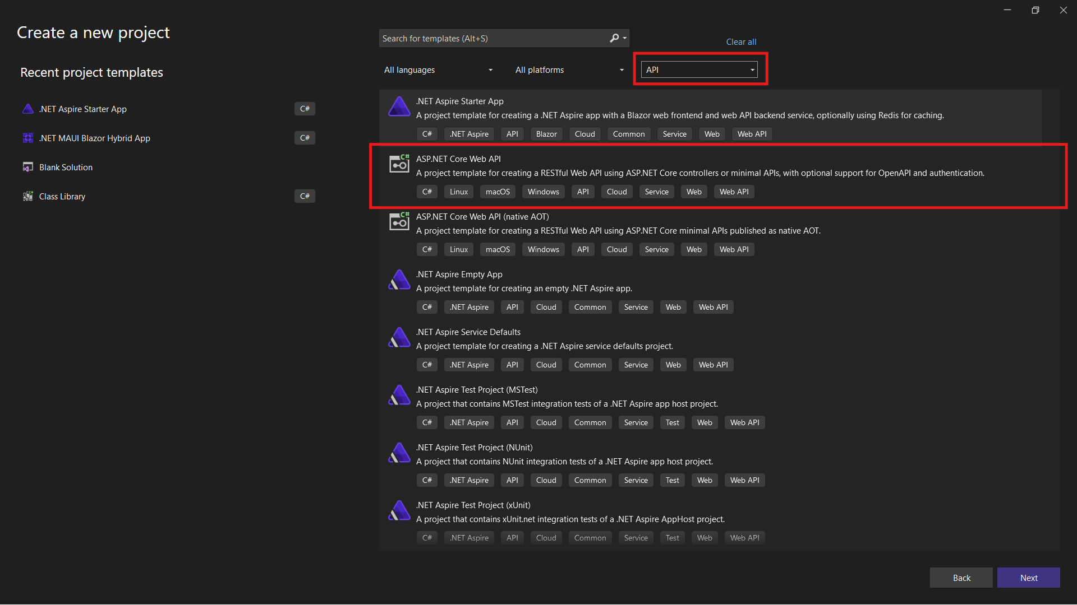
Visual Studio

Slide 25
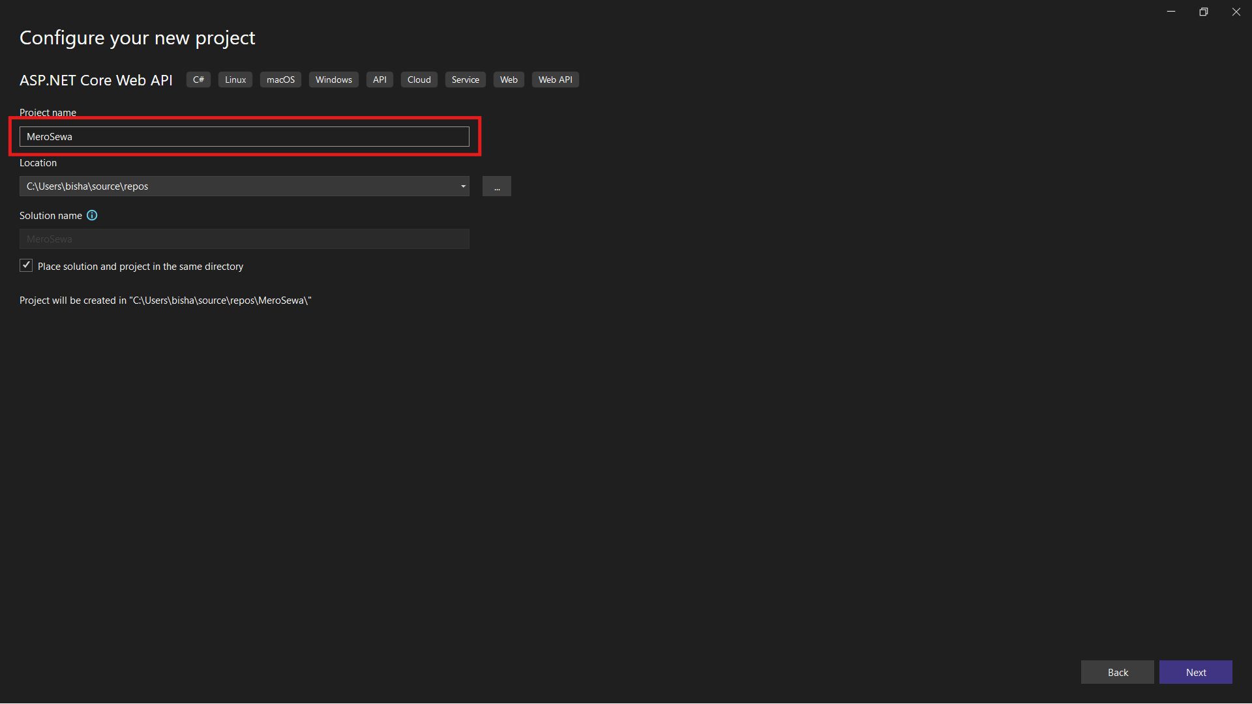
Visual Studio

Slide 26
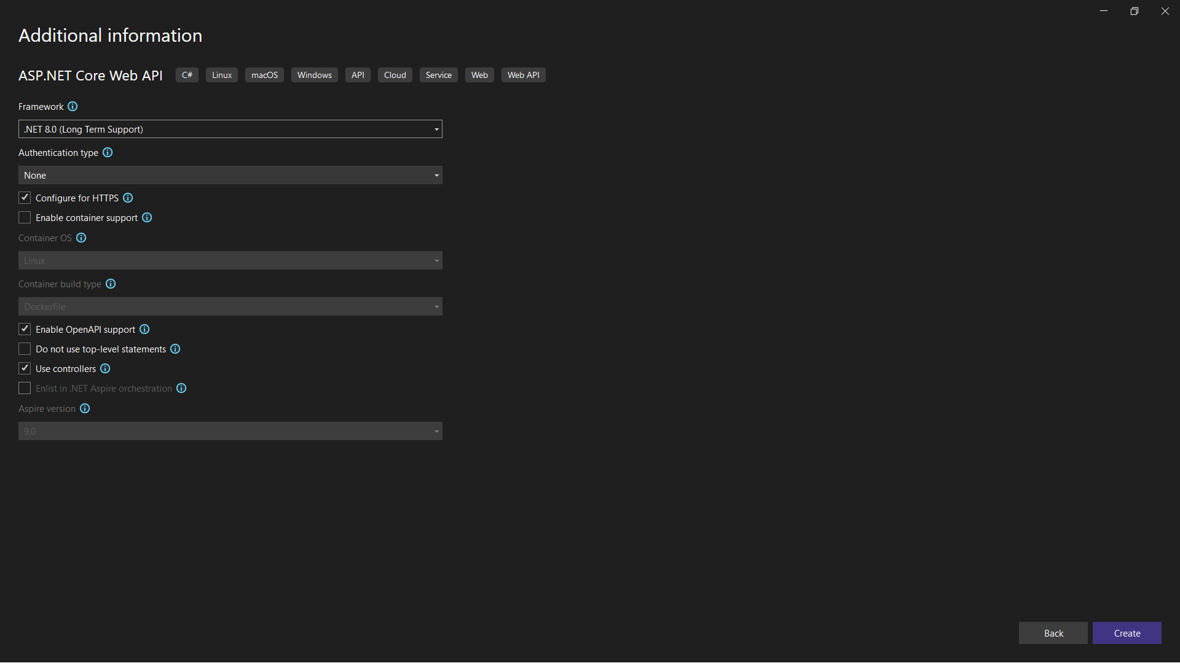
Visual Studio

Slide 27
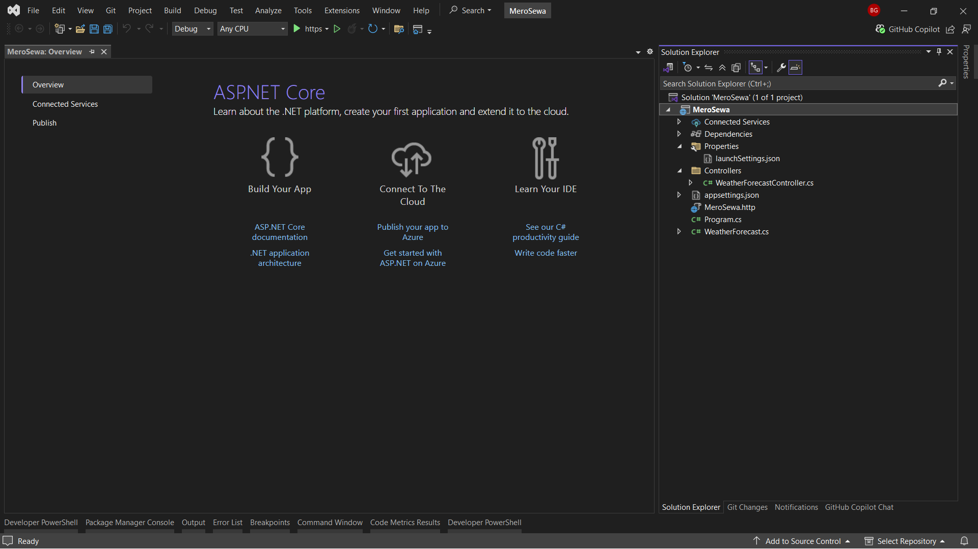
Visual Studio

Slide 28
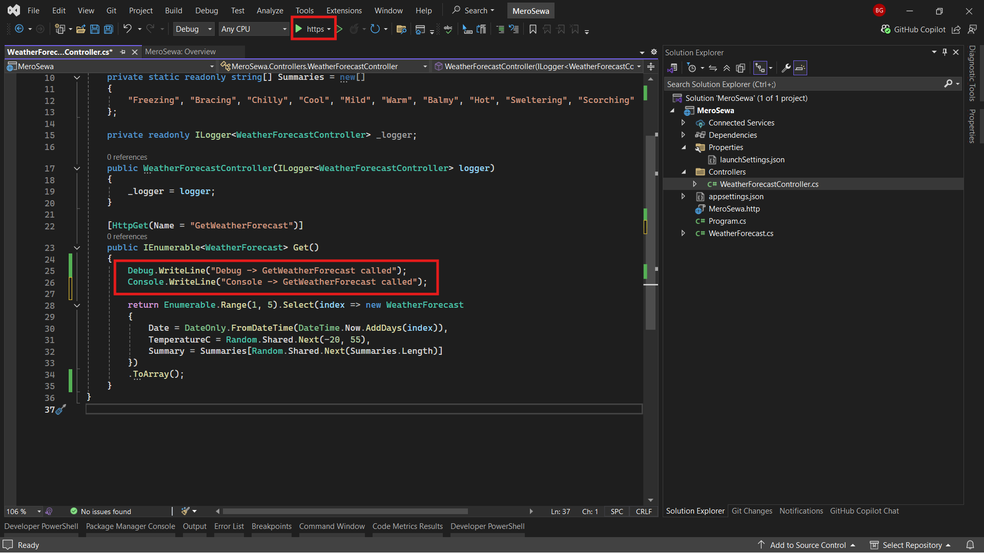
Visual Studio

Slide 29
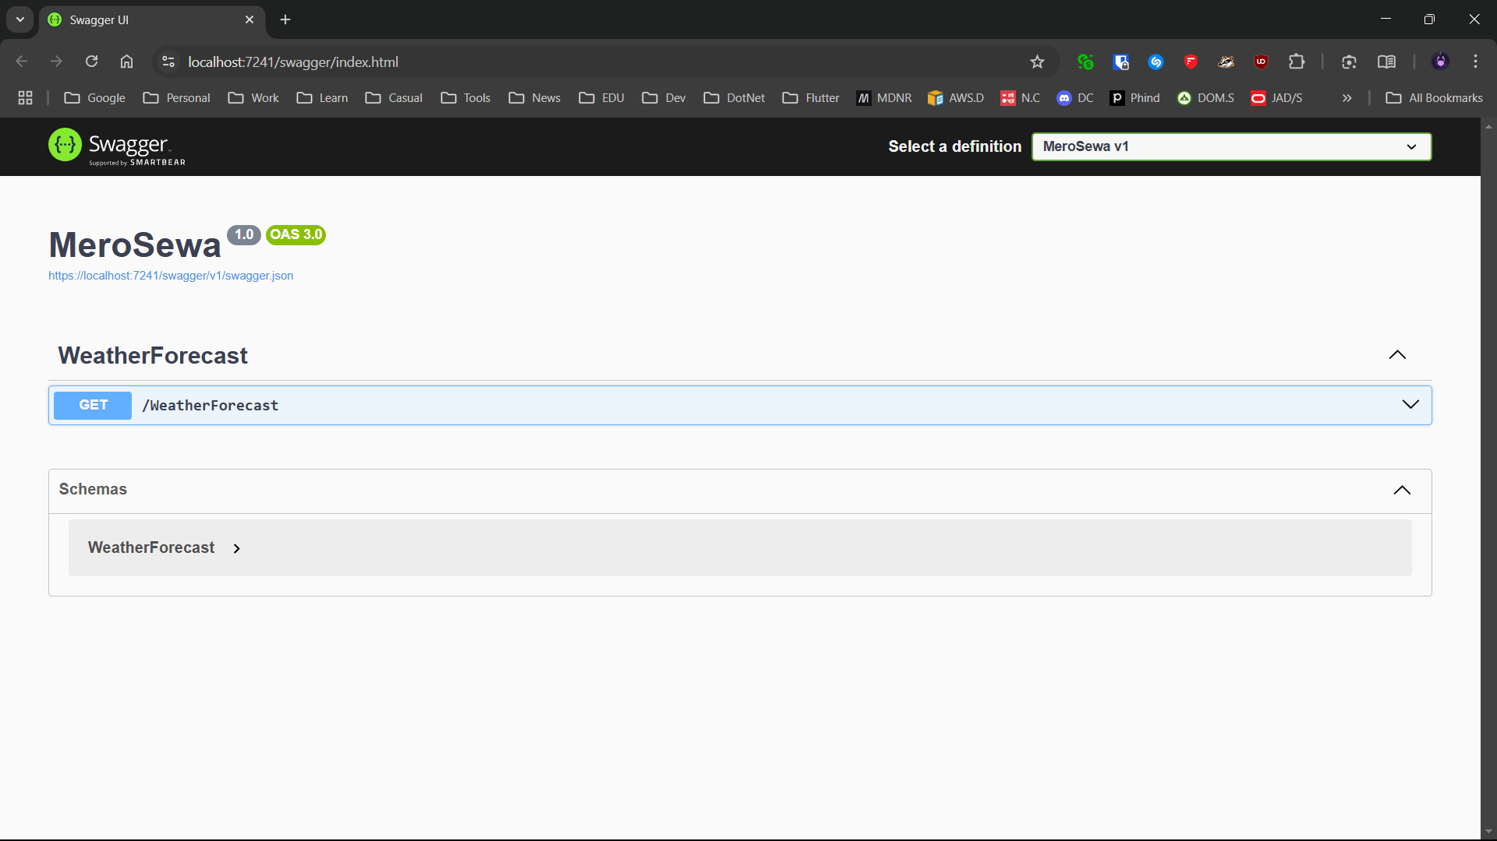
Swagger UI

Slide 30
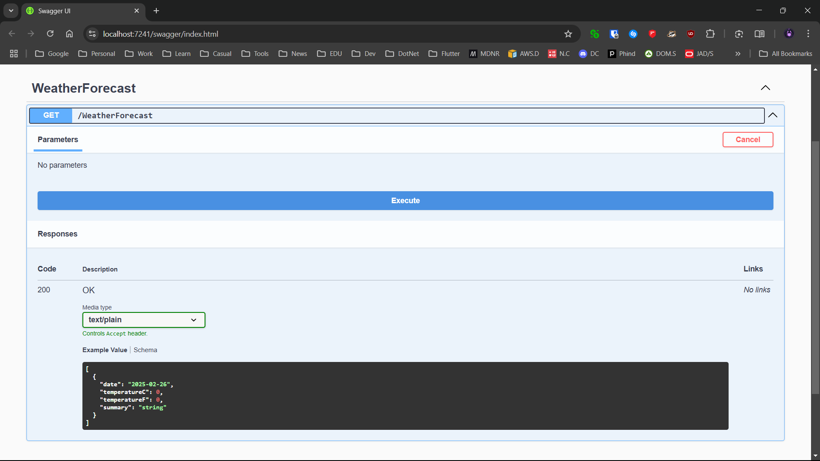
Swagger UI

Slide 31
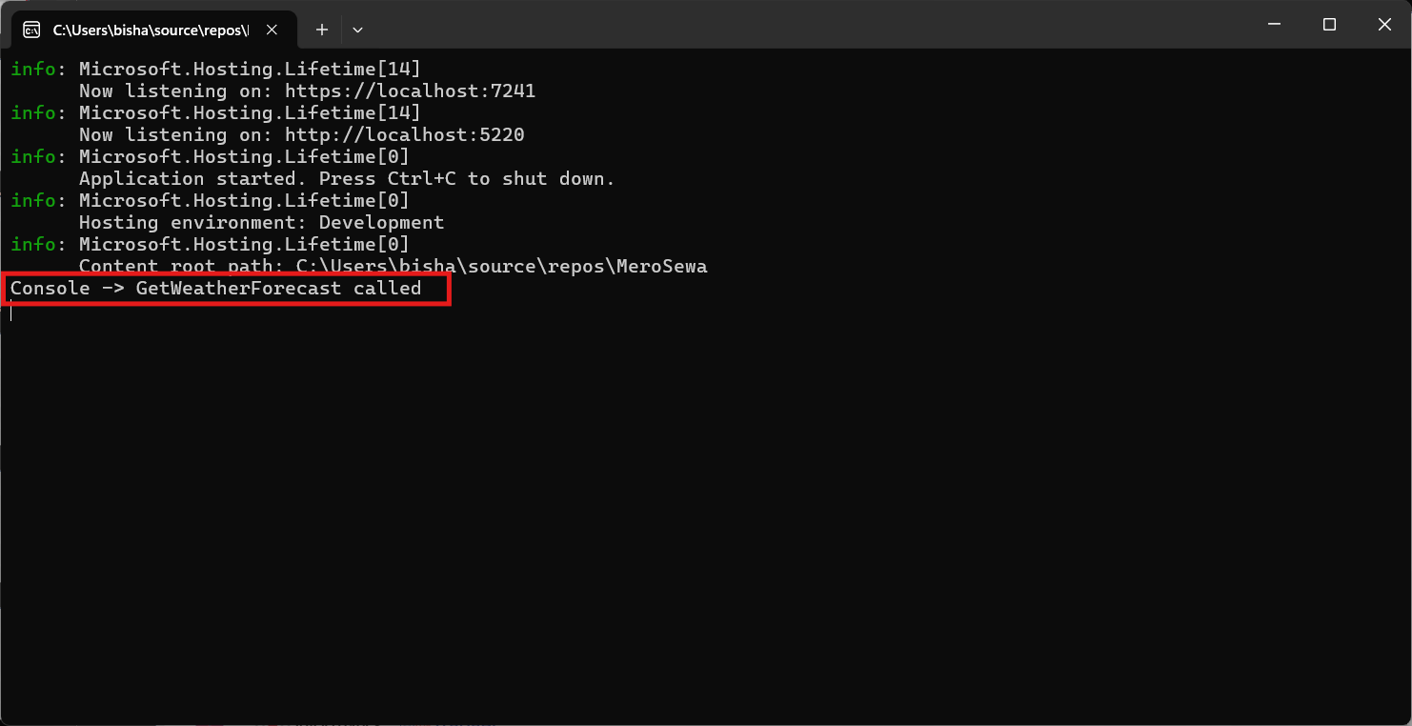
Visual Studio > Console

Slide 32
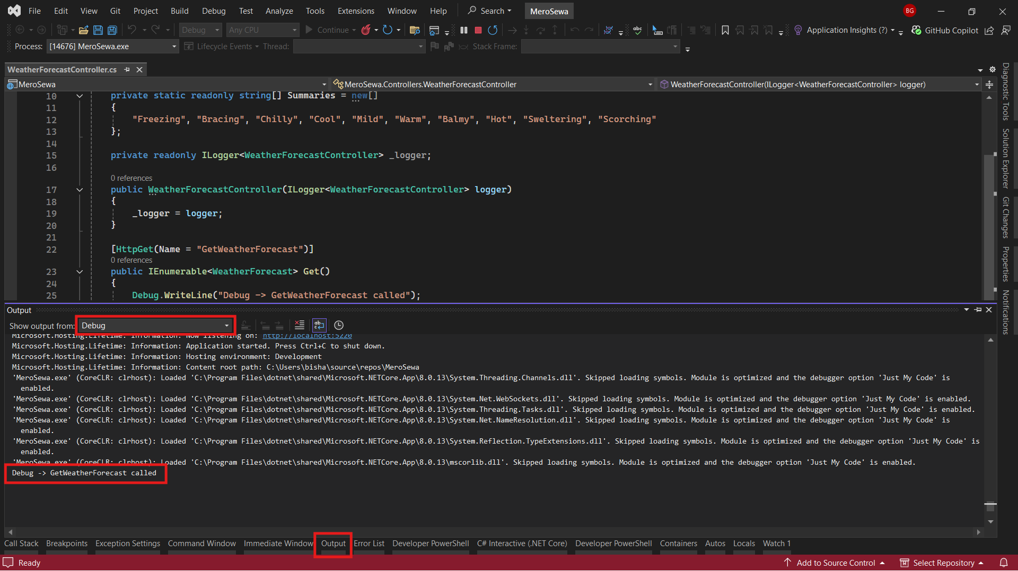
Visual Studio > Debug Output

Slide 33

Rider
(Mac, Linux & Windows)
https://www.jetbrains.com/rider/
https://www.jetbrains.com/shop/eform/students

Slide 34
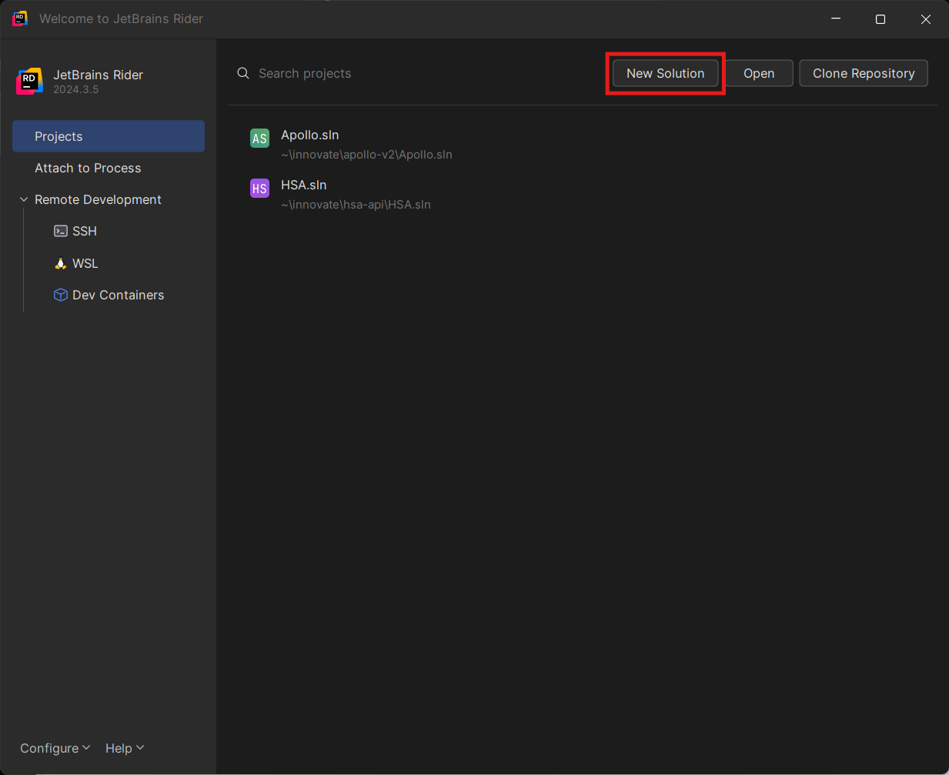
Rider

Slide 35
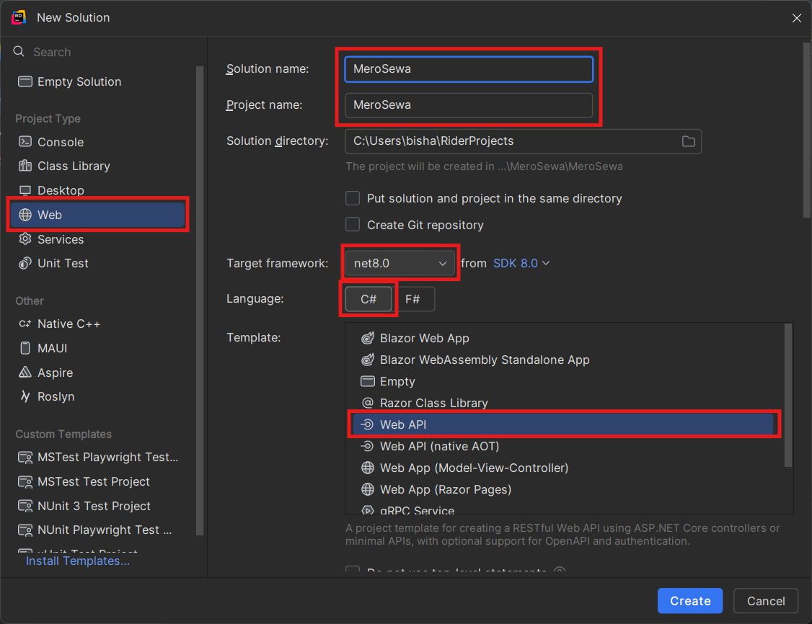
Rider

Slide 36
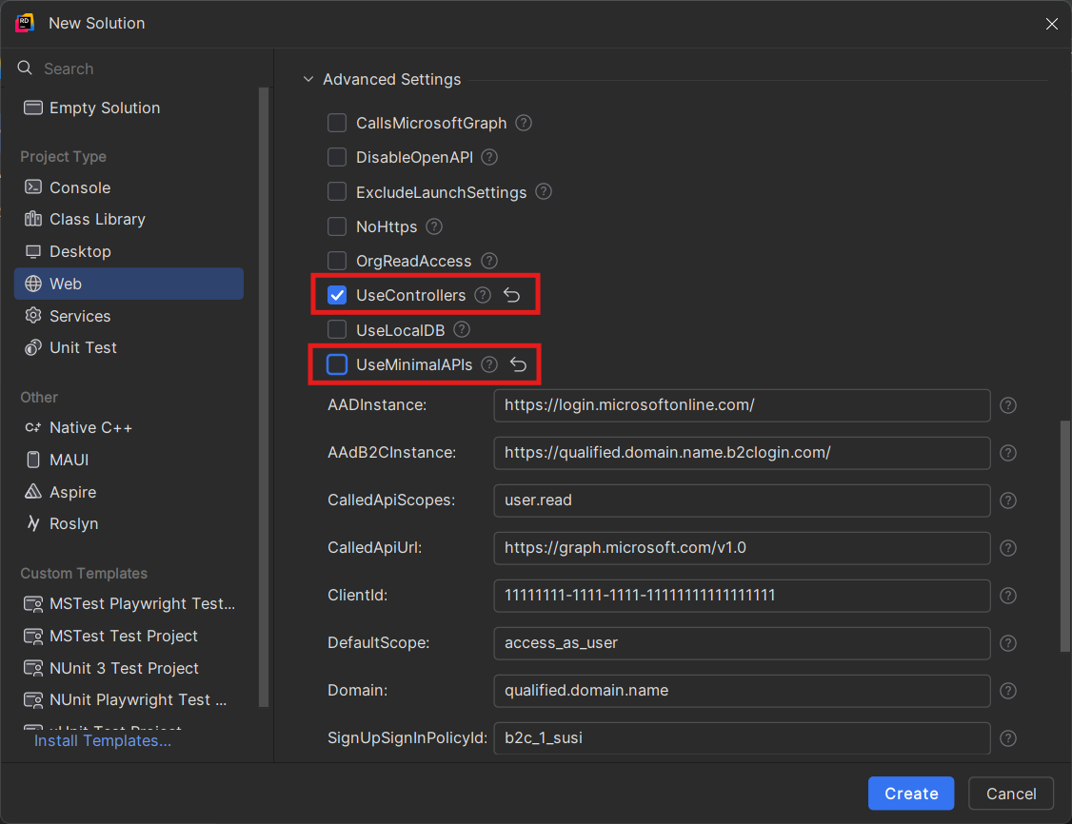
Rider

Slide 37
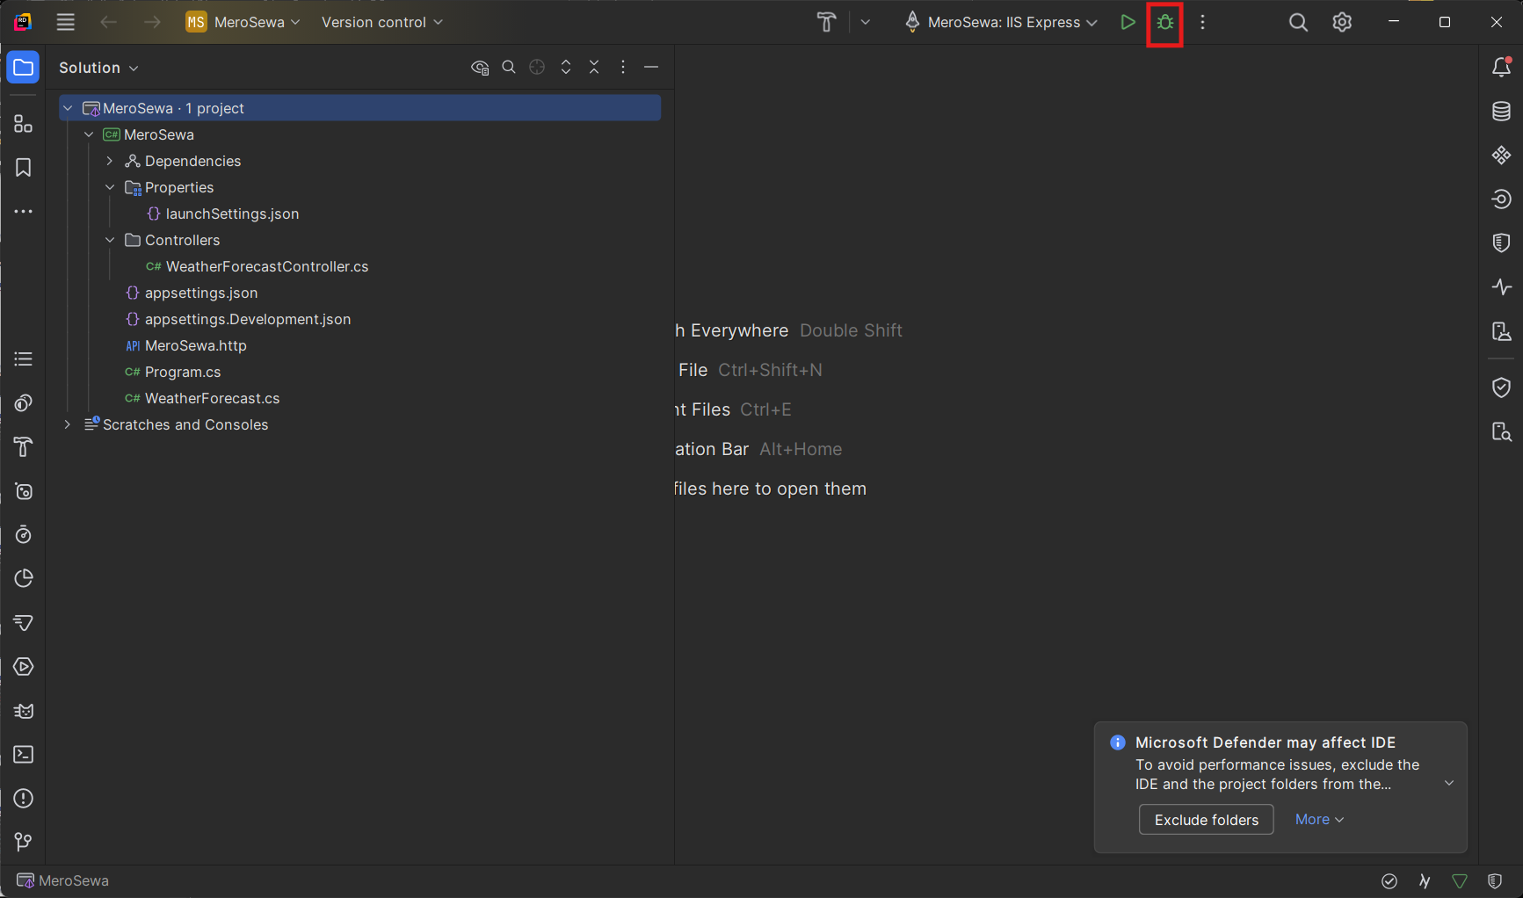
Rider

Slide 38
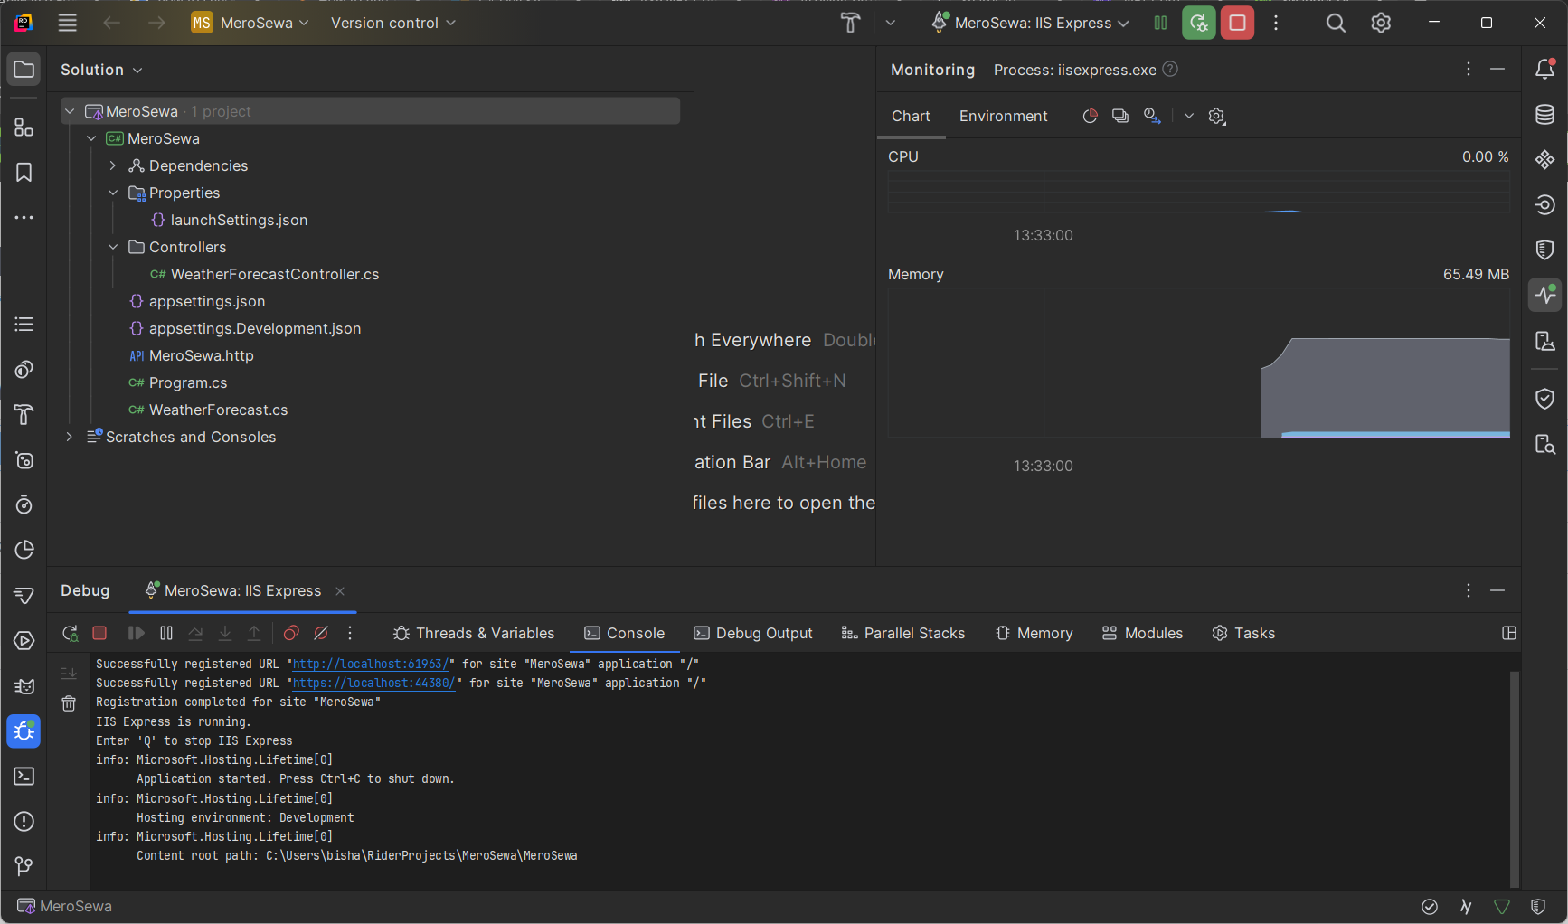
Rider

Slide 39
Useful Resources

Slide 40
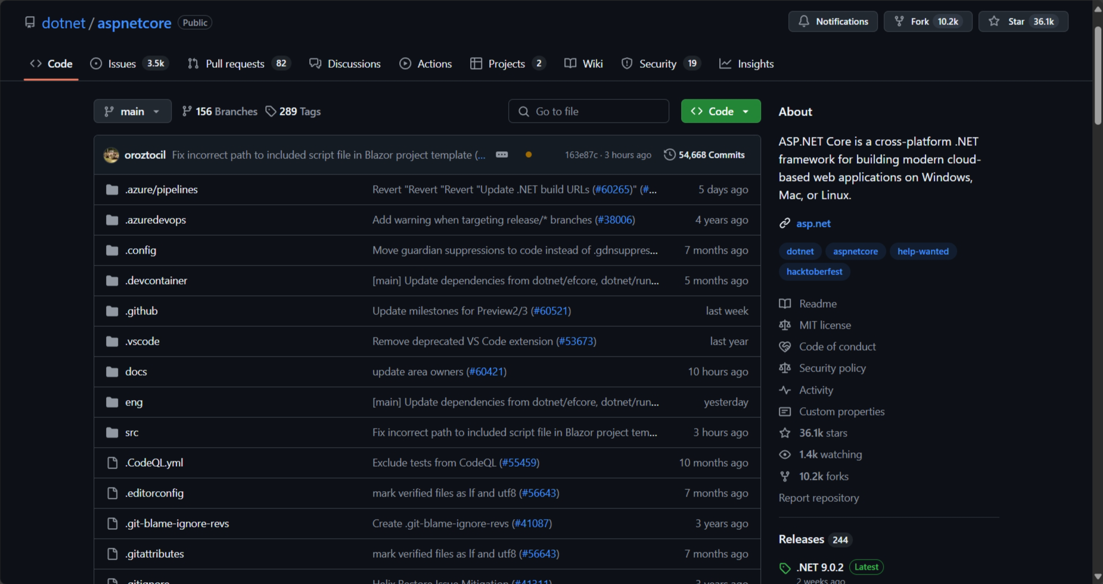
github.com/dotnet/aspnetcore

Slide 41
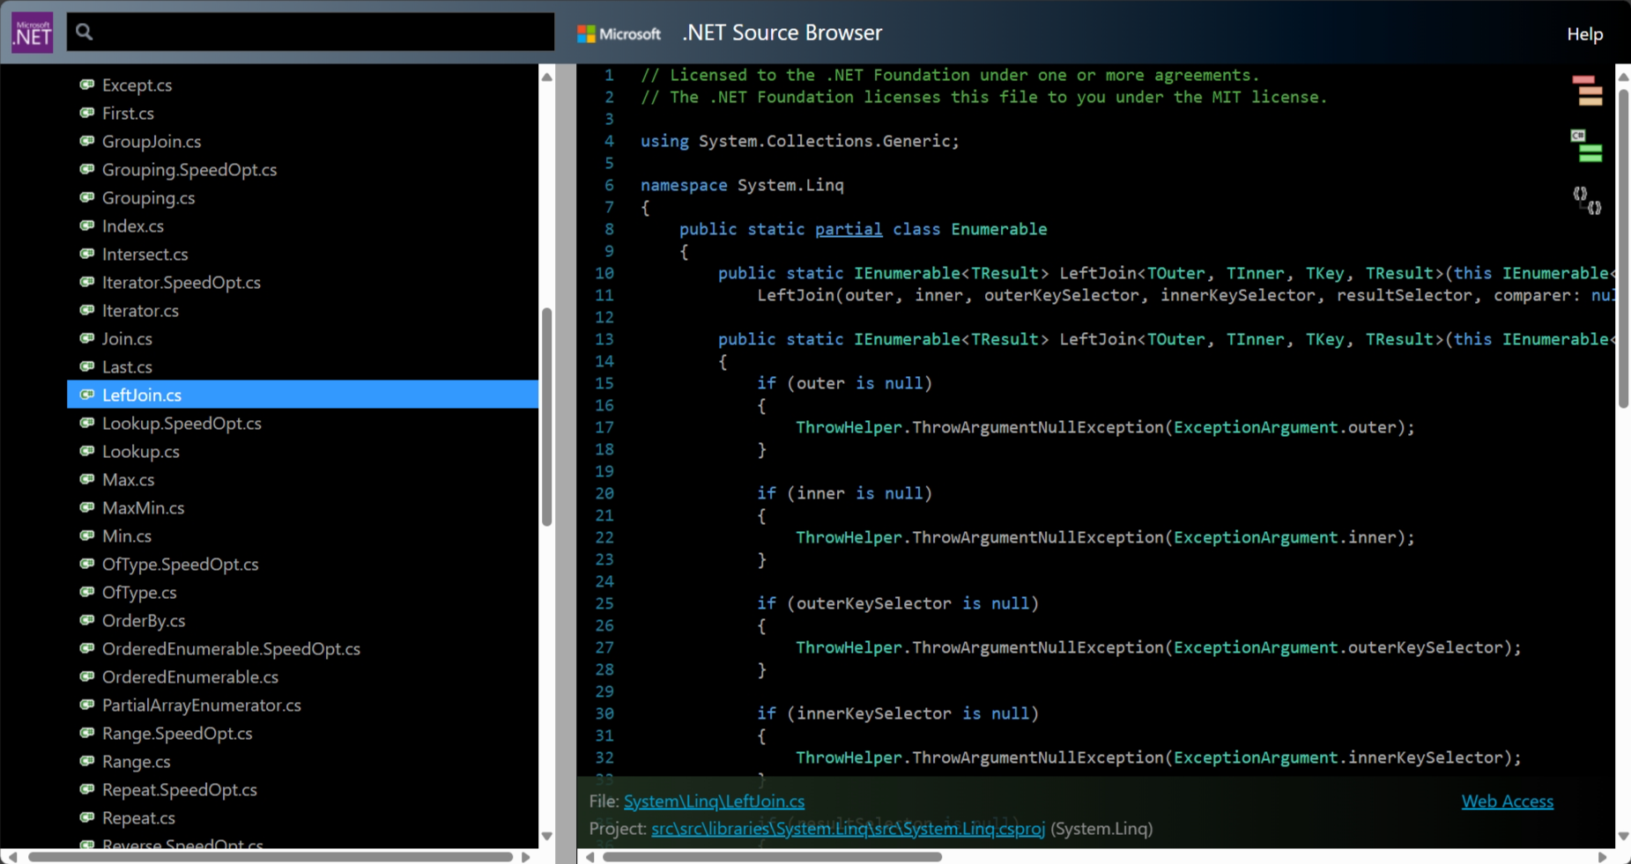
source.dot.net

Slide 42
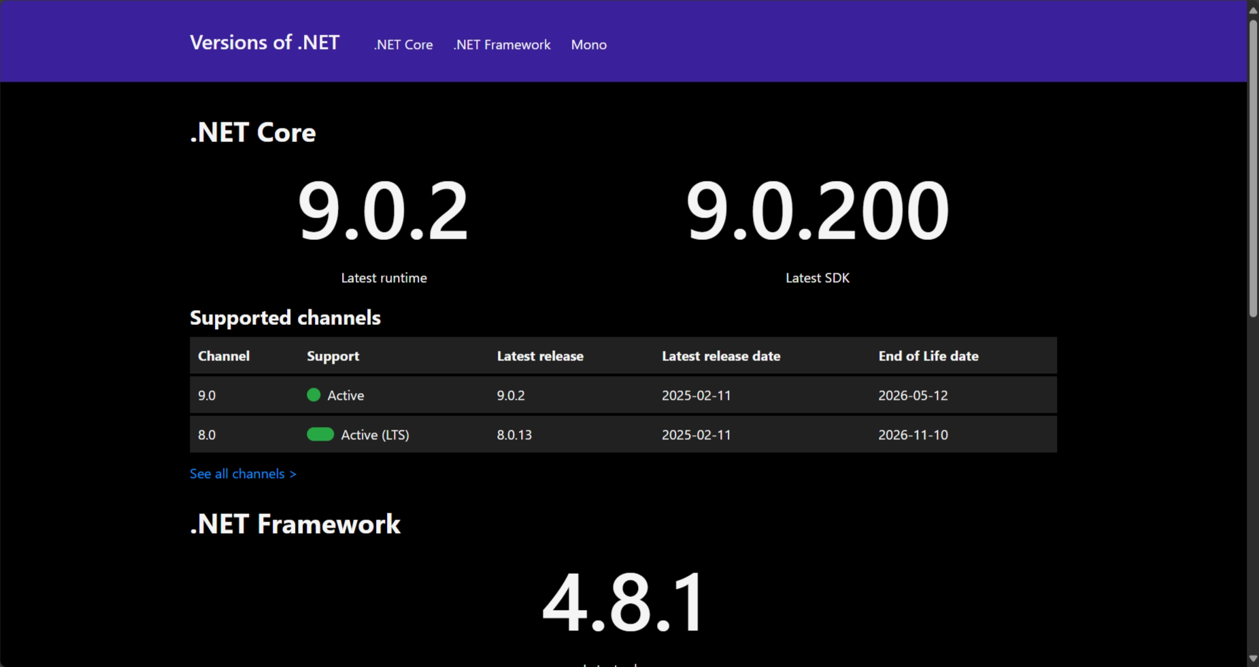
versionsof.net

Slide 43
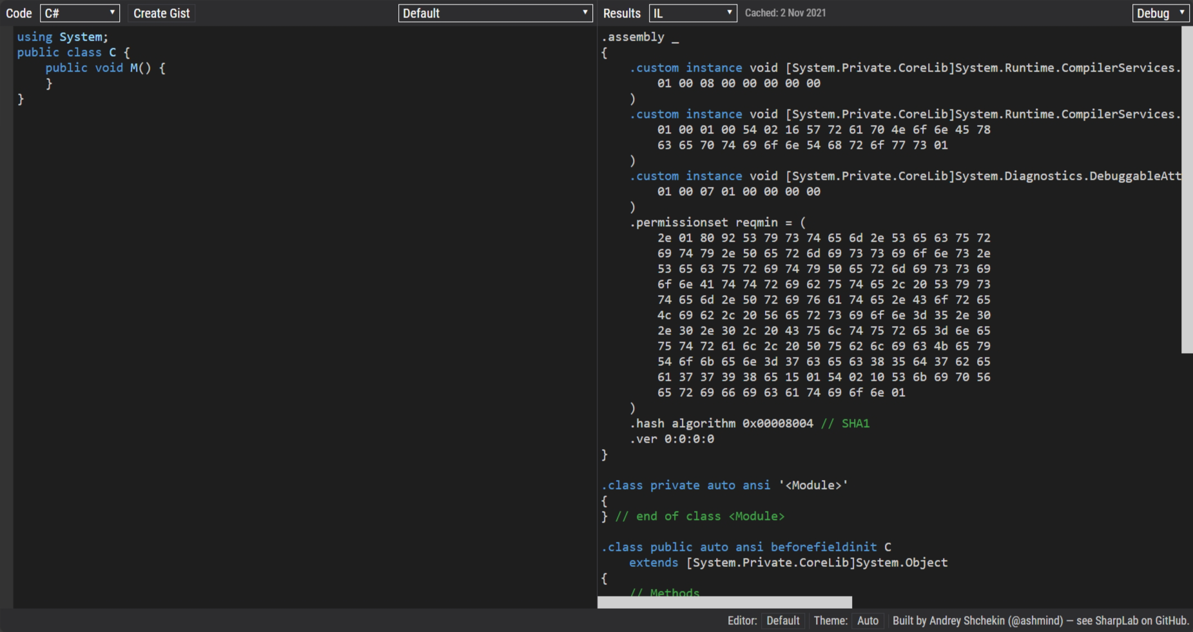
sharplab.io

Slide 44
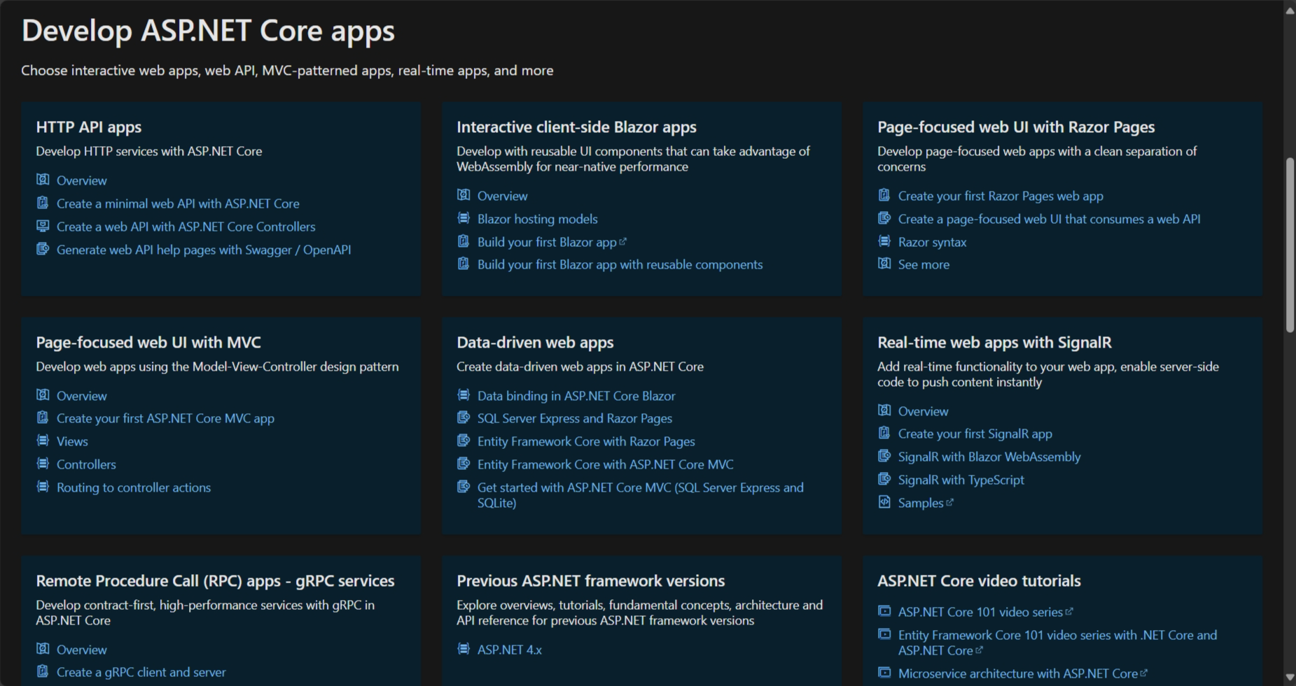
learn.microsoft.com

Slide 45
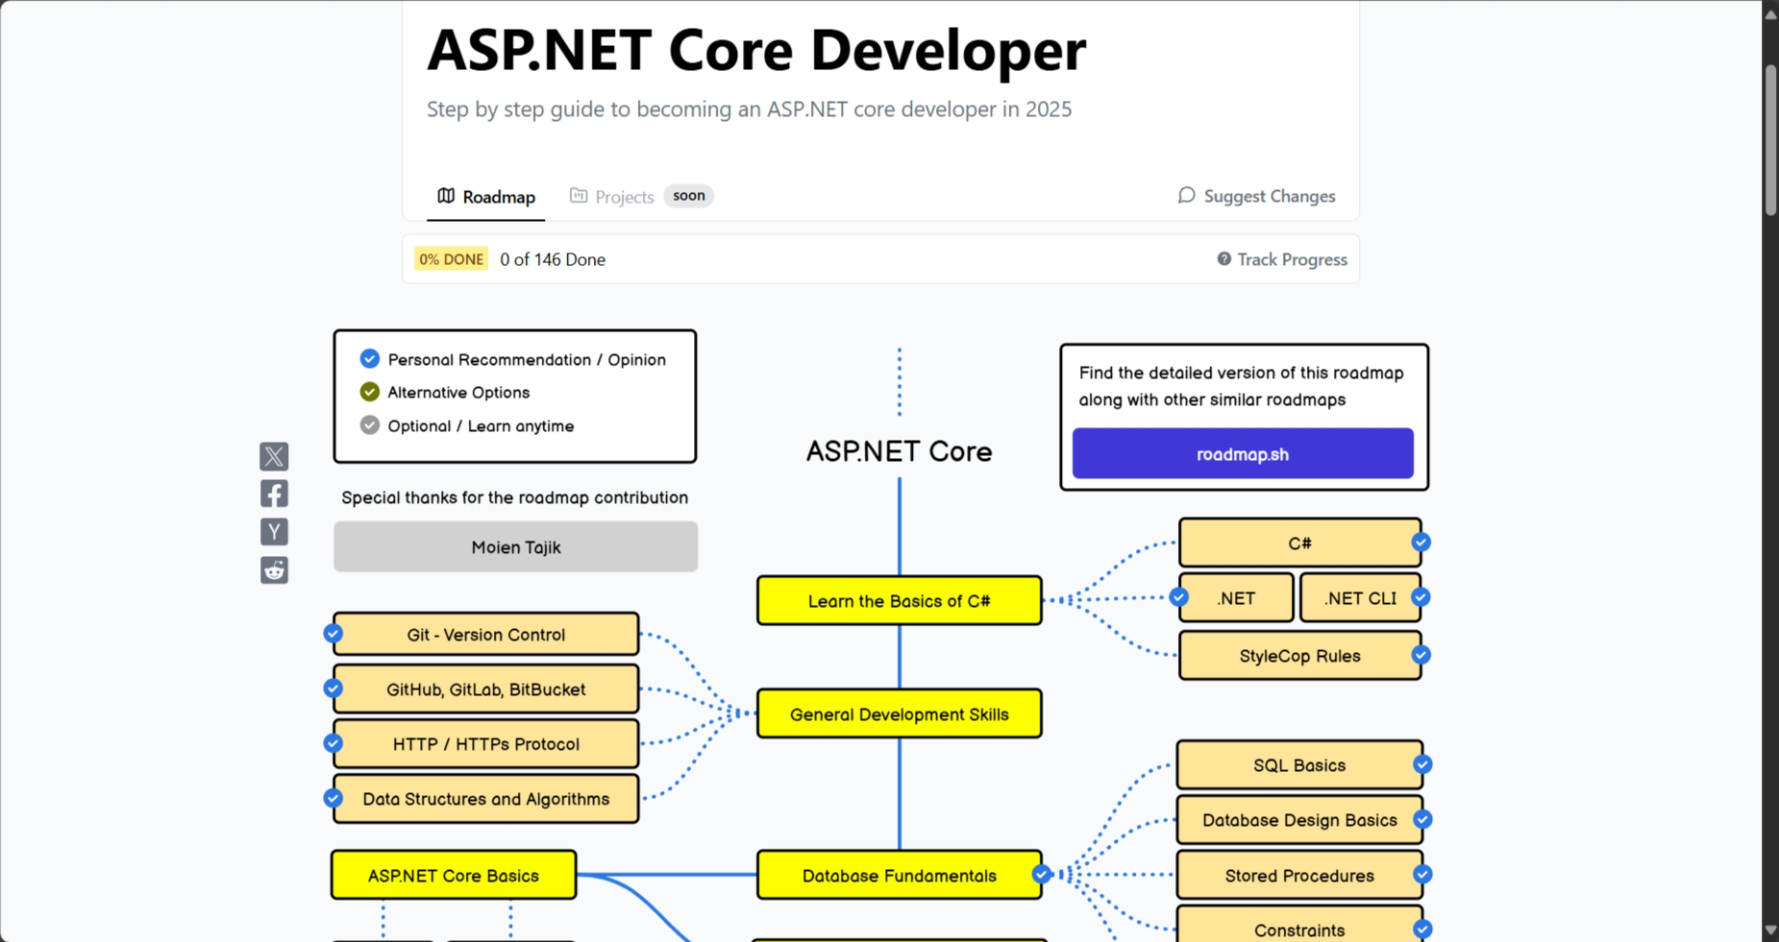
roadmap.sh/aspnet-core

Slide 46


